Slide 1

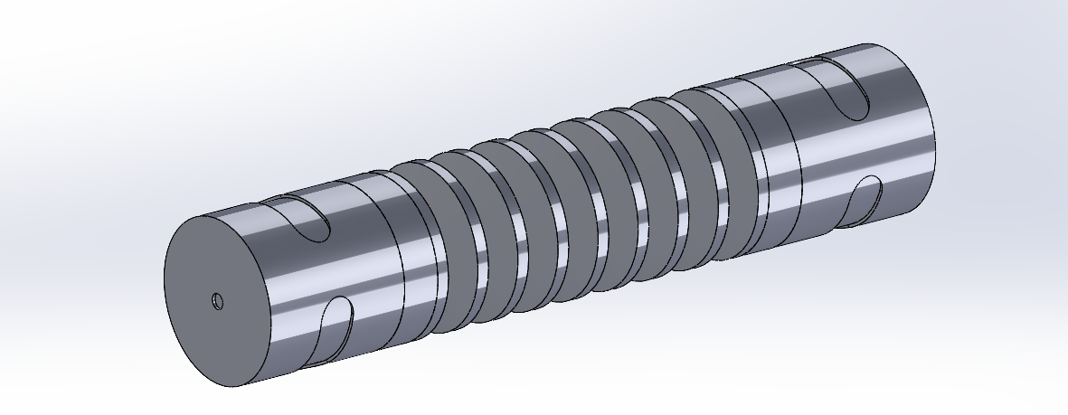
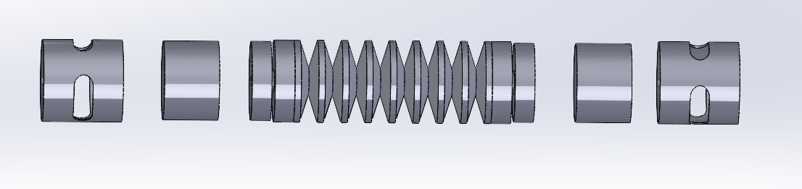
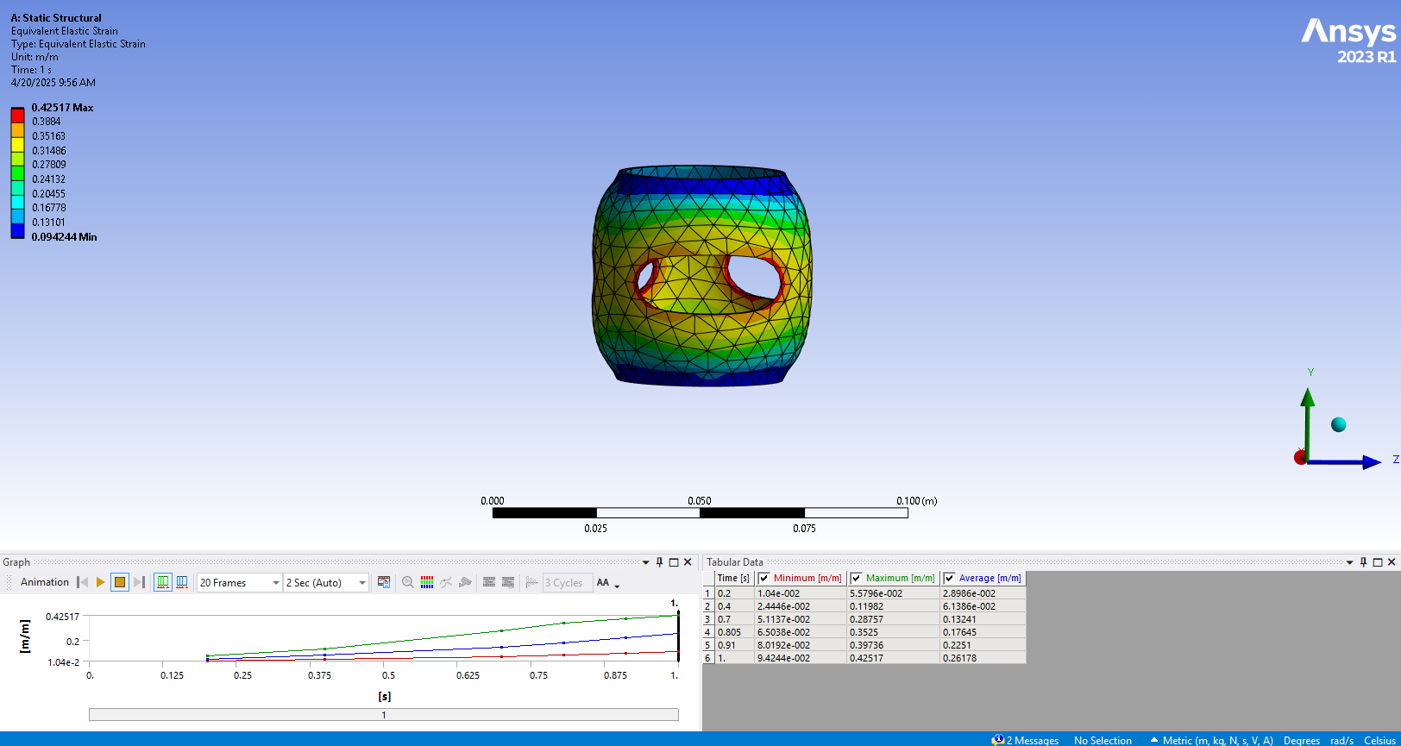
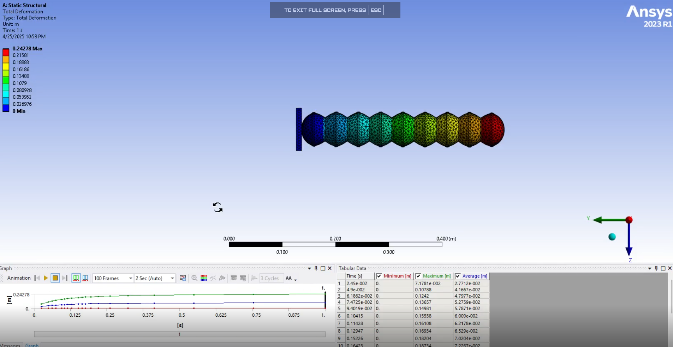
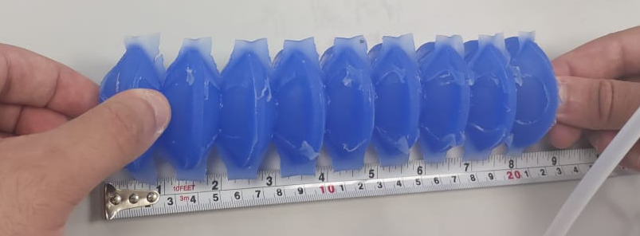
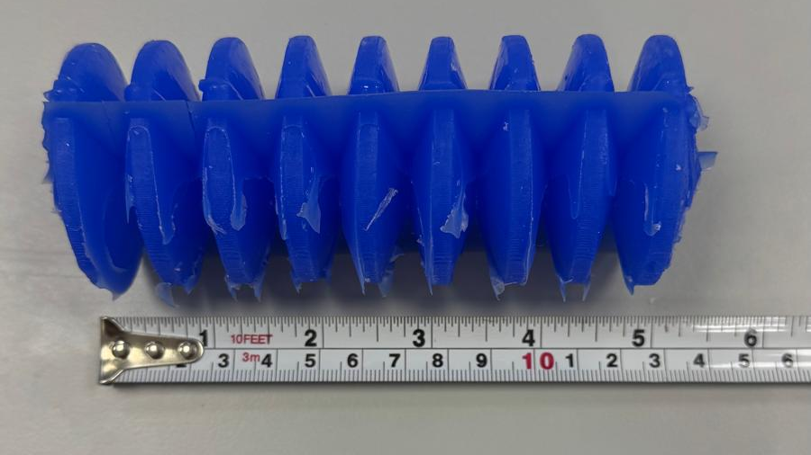
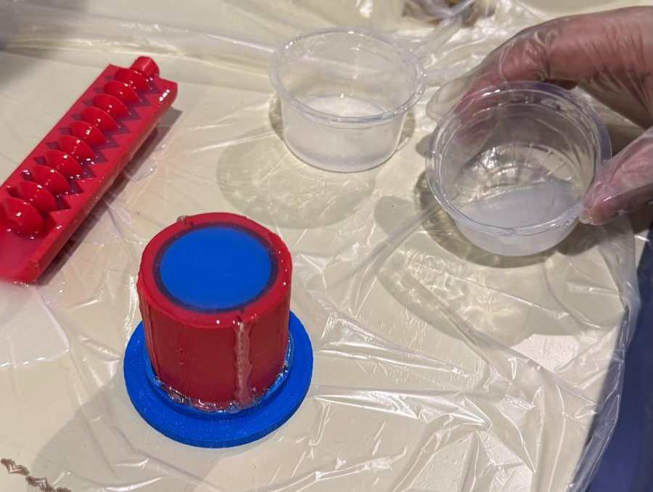
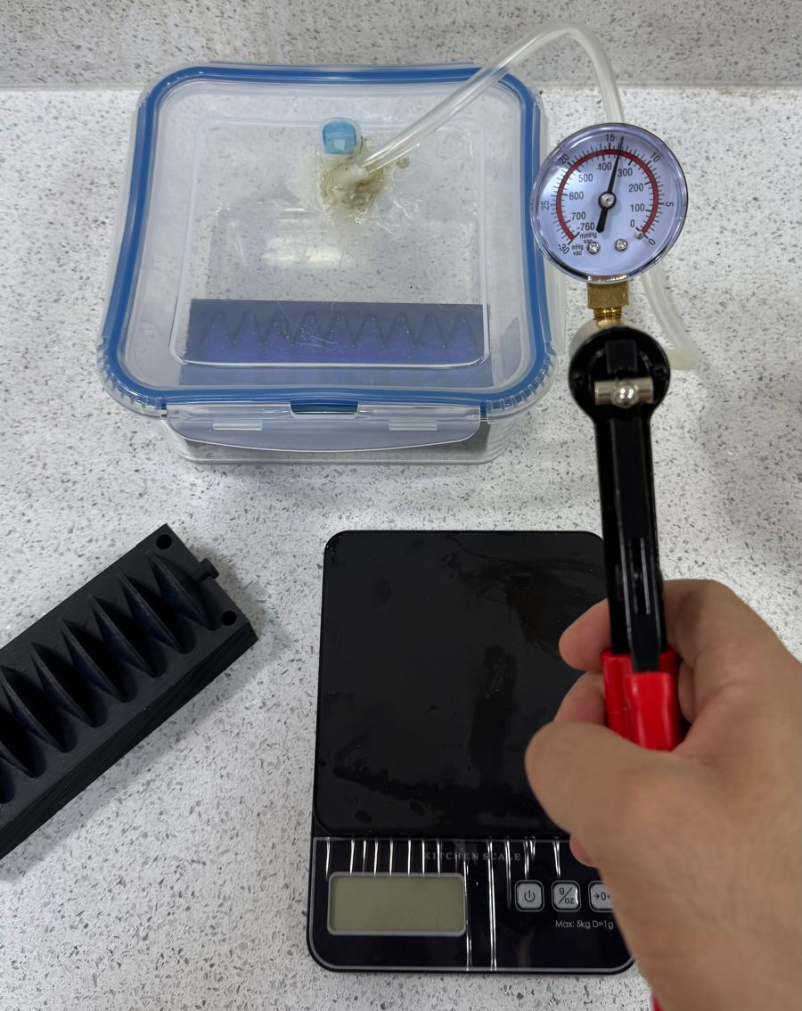
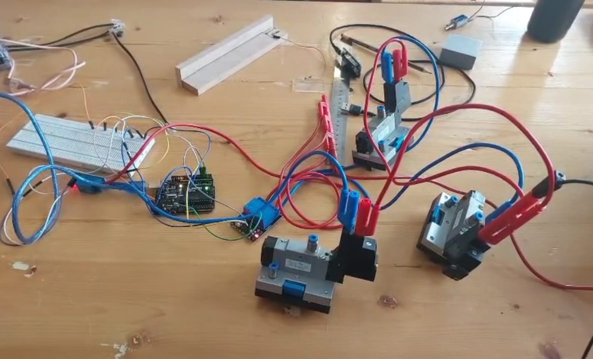
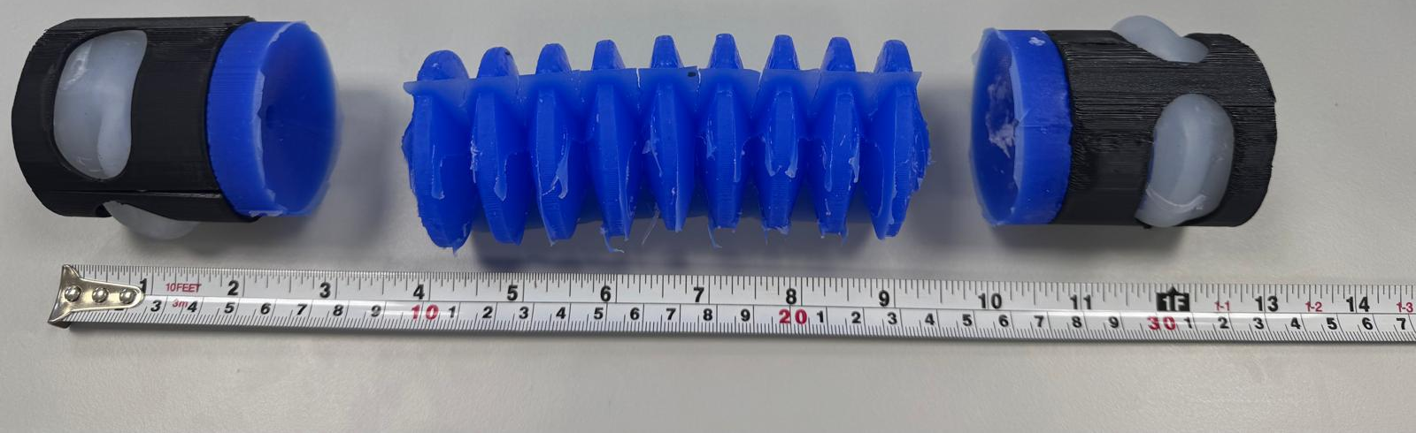
Faculty of Engineering
Design and Development of locomotion design of a bio-inspired Soft Crawler Robot for Pipeline Inspection.
Student: Fadhel Ali – 201902117, Abdulla Salman - 202101289
Supervisor: Dr. Ahmad Abdulrahman, Dr. Belal ElSayed
1. Introduction
4. Methodology
CAD Model
This project focuses on designing a soft robot crawler that can inspect pipelines using soft actuators. The robot combines radial and linear expansion mechanisms to adapt to tight and variable pipe geometries while minimizing damage to internal surfaces.
Radial Actuator: Expands outward to press against the inner pipe walls, anchoring the robot during motion.
Linear Actuator: Extends the robot’s body forward inside the pipe, enabling crawling movement.
Inner Balloon Mechanism: A soft balloon embedded in the radial actuator inflates under pressure and expands through grooves in the solid outer shell to achieve outward gripping.
2. Problem Statement
Finite Element Analysis
Inadequate Data Analysis Tools
Difficulty in Navigating Confined Spaces
Challenges with Environmental Conditions
Low Flexibility of Existing Solutions
3. Objectives
Design a Cost-Effective Crawler Robot for Pipeline Inspection.
Enhance Mobility for Navigation in Various Pipeline Conditions.
Integrate a High-Quality Camera for Real-Time Imaging.
Increase Durability Against Harsh Environmental Conditions.
Promote Safety by Reducing Personnel Exposure to Hazards.
5. Experimentation
Fabrication
Linear Actuator Deformation Result
During testing, the soft robot’s linear actuator expanded from an initial length of 5 inches (127 mm) to 8 inches (203.2 mm) when pressure was applied. This resulted in:
Total elongation: 76.2 mm
Elongation percentage: 60%
This confirms the actuator’s capability to stretch significantly while maintaining structural integrity, making it suitable for forward crawling inside pipelines.
6. Conclusions
Designed a soft robot crawler with radial and linear actuators for flexible pipeline inspection.
Simulations in SolidWorks and ANSYS confirmed safe deformation and effective movement.
The concept offers a low-cost, damage-free solution to improve efficiency in pipeline maintenance.

